Slide 1

Movie Data Analysis for Microsoft
By Robert Kidake Kalafa

Slide 2

Microsoft is preparing to launch a new film studio, emphasizing the importance of factors that can boost profitability. By delving into historical data, we've unearthed key insights to optimize film production for both performance and return on investment.

Slide 3

To furnish Microsoft with insights to evaluate the prerequisites for a prosperous venture into the film production industry.

Slide 4

Business Problem
Microsoft aims to tap into the lucrative movie-making industry, yet they find themselves at a crossroads, uncertain about the path forward. The challenge for their nascent movie studio lies in its readiness to dive into the industry without the requisite expertise.
Microsoft is also keen on ensuring that its movie studio stands out and thrives in the competitive digital content market.

Slide 5

Data Sources
My analysis involved gathering data from the following sources:
The Movie Database
The Numbers Movie Budgets
Box Office Mojo.

Slide 6

Data Methods
Data cleaning – Dealing with missing data
Converting column types – Ensuring that data in the columns are in the correct type to allow for data manipulation
Feature engineering – Creating new columns in the data to create more insights
Data analysis – Exploration of data to establish meaningful insights
Data visualization - visual representations using charts, graphs, etc. to communicate complex data in a clear and understandable manner.

Slide 7
Key Findings
Higher production budgets does not necessarily mean higher returns.
Microsoft may face challenges entering the film industry despite potentially acquiring IP rights from top studios due to lack of experience in film production.
Consider popular genres for movie creation.

Slide 8
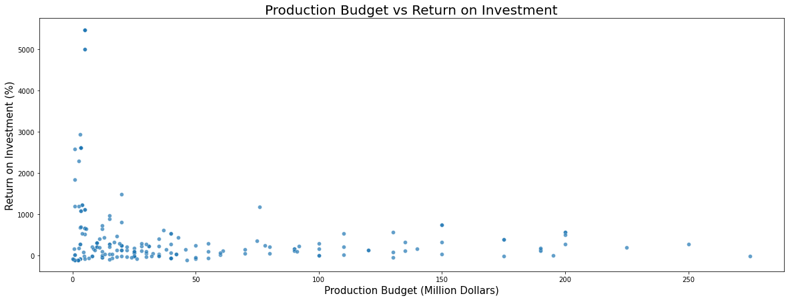
1. Production Budget Vs Return on Investment Graph

Slide 9

Correlation: ROI vs Production Budget
The weak positive correlation between production budget and return on investment suggests that higher production budgets do not necessarily guarantee higher returns.
This means that Microsoft may need to carefully manage its production costs and investments to ensure a profitable return on investment

Slide 10
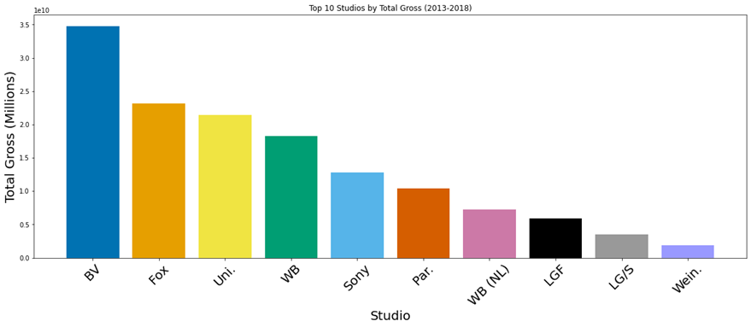
2. Best Performing Studios in terms of Gross Income

Slide 11

The top 5 performing studios in terms of gross income are:
1.Walt Disney Studios - BV
2. Warner Bros. Pictures
3. 20th Century Fox
4. Universal Pictures
5.Warner Bros. Pictures

Slide 12
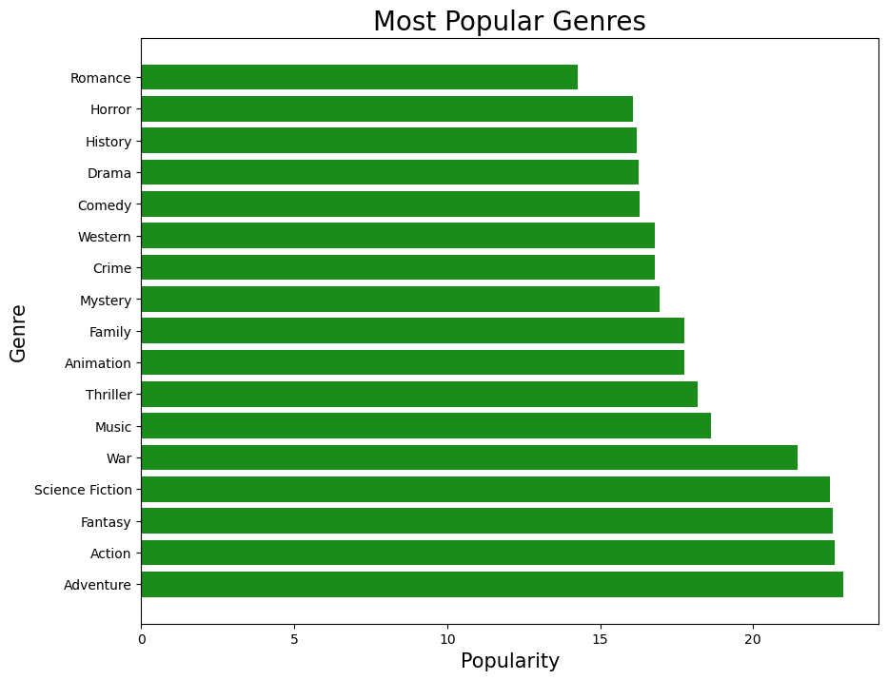
3. Popular genres

Slide 13
Genre Popularity
My analysis shows that the following genres are quite popular with movie lovers:
Adventure
Action
Fantasy
Science Fiction
War

Slide 14
Conclusion and Recommendations
To position itself effectively in the movie industry, Microsoft should consider the following strategies:
Acquire intellectual property rights from leading movie studios as an entry point.
Exercise prudent management of production expenses and investments.
Emphasize high-budget productions to enhance market presence.
Explore opportunities in popular and lucrative genres like Horror, Music, Action, and Adventure.

Slide 15


